Slide 1
Kotlin – Advanced - Introduction
2019

Slide 2
Kotlin – Agenda
Exceptions
Java interop
Collections
Standard Extension Functions
Helpful extensions
Types
Spring
Concurrency
More about Extensions + Lambda with receiver
Misc

Slide 3

Co to je? Kde to je?

Slide 4
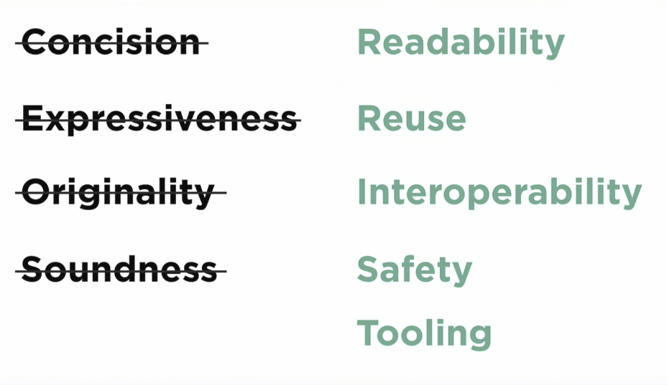
KotlinConf 2018 – Andrey Breslav
https://youtu.be/PsaFVLr8t4E?t=146

